Slide 1
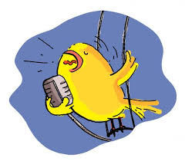
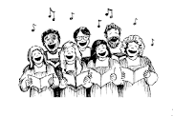
Asia Kodaly Symposium Saturday, August 18, 2018
Title: Choral Sound-building Techniques
Description: this participatory workshop will progress through several important aspects of vibrant choral sound. Some to be covered will be posture, breathing, resonance, singing through the passaggio, intonation, color, and dynamics, as well as ideas about singer placement with a section

Slide 2
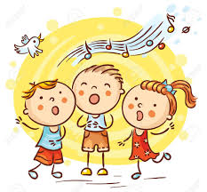
Presentation outline
Introduction: why it matters
Posture
Breathing
Finding resonance
Singing through the passaggio
Vowel modification
Dynamic flexibility
Chord balance
Intonation
Singer placement within sections

Slide 3
Introduction
“if you want your choir to sound better…
…find better singers!”
True educators reject this idea
We work with who we have
Slowly, patiently build
Teach for the long journey
Everything we do has purpose
Part of a larger goal
No space-fillers
Today’s topics…
…maybe mostly just review
…if one or two give new ideas: a success!

Slide 4
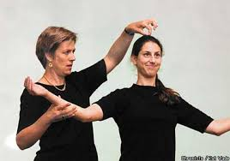
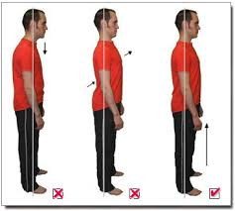
Posture
Singer’s posture means what?
Tall spine
Tail tucked in
Shoulders back

Slide 5
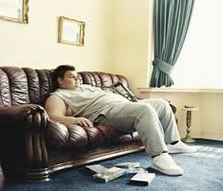
My choir members before rehearsal

Slide 6
Posture
I assume they will arrive “out of posture”
My first job is to help them get into good posture
Good posture components:
High sternum
Tall spine
Shoulders relaxed and slightly back
Head erect, chin slightly tucked (not forward or up)
Tail tucked in!
Knees not locked
Feet almost shoulder-width apart

Slide 7
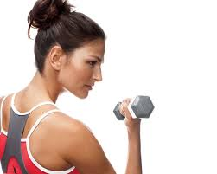
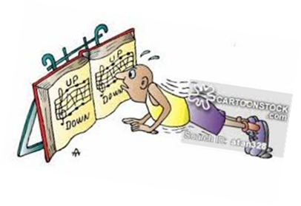
A few exercises
Singing is a physical and mental activity
Engage muscles
Increase heart rate
Get ‘out’ of posture
Push-ups/outs/downs
Tai-bo and reverse Tai-bo
Rag doll, roll up from spine
Backwards shoulder roll while inhaling, raising sternum
Raise arms up from front, bring back down from sides
Feel “tall spine” and “high sternum”
Watch your singers, look for problem posture, address problem with exercise

Slide 8
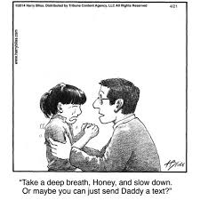
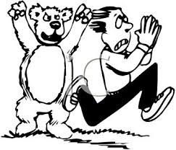
Breathing
Posture and breathing are VERY important parts of good choral sound
Proper breathing outside of rehearsal???
Probably almost never
Relaxed, non-singing:
…maybe 15-20% of breathing capacity
Running for your life:
…maybe 100%??
Singing: should have all capacity available

Slide 9
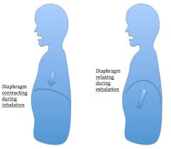
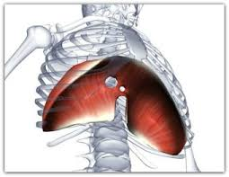
Breathing: the diaphragm
Standard American choir instruction: “breathe with your diaphragm!”
…separates lungs/heart from stomach and lower organs

Slide 10
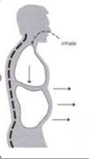
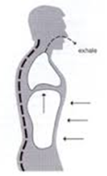
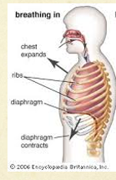
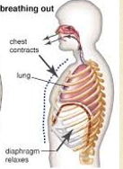
Diaphragm…
…when contracts, pulls lungs down = inhalation
…when relaxes, allows lungs to shrink = exhalation
But, diaphragm is only a part of the breathing picture

Slide 11
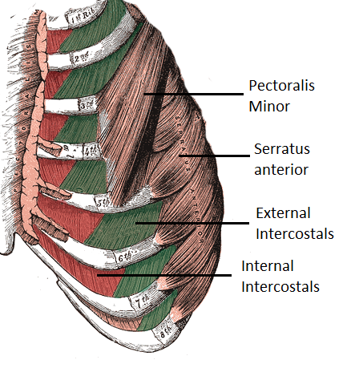
Abdominal muscles…
Two sets of rib muscles work in tension
External pull ribs up (inhalation)
Internal pull ribs down (exhalation)
Notes:
Two work in tension, like biceps and triceps

Slide 12
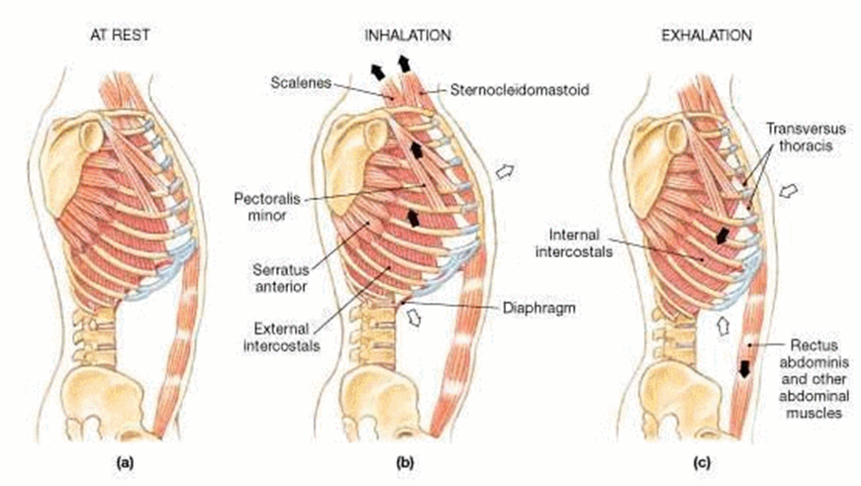
Abdominals
Another picture

Slide 13
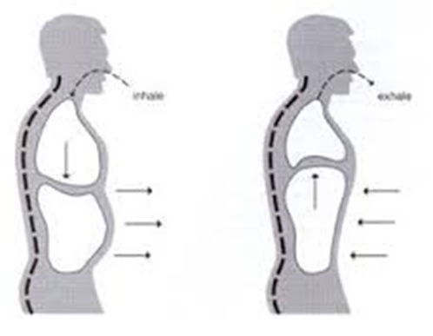
The power of tension
Proper singing breath support comes from…
Balanced tension between relaxing diaphragm and
Pulling internal intercostal muscles
Without expanded/elevated posture, this tension will not work

Slide 14
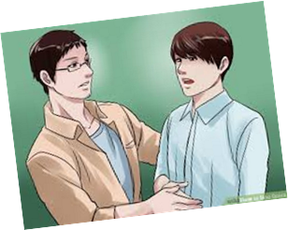
Bottom line…
Good choral sound depends on good breathing technique
Our singers walk into rehearsal…
…breathing muscles asleep
We must…
…wake them up
…fine tune them

Slide 15
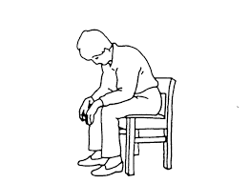
A few exercises…
Vigorous exhalation/inhalation on fricatives (F, S)
Gradual increase of numbers per pulse [s] and [f]: 2, 3, 4, 5, 6 very light, energetic
Full expansion/compression of space: counting ‘s’
4-8-12-16-24-36 etc
Scale with vigorous breathing on voiced fricatives [v, ʒ] do-so do-do
Deep inhalation while…
Arms above head
Lying down on back
Sitting with elbows on knees

Slide 16
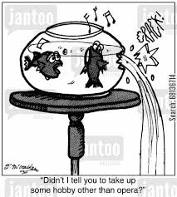
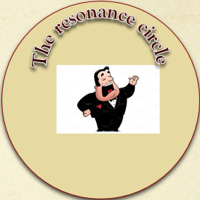
Resonance
The resonance circle…
…enter it with the first sounds
…never leave it!
all exercises should contribute to resonant sound

Slide 17
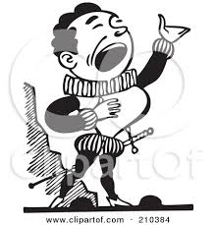
Building resonance
Begin in easiest places
Speaking range
Moderate volume
Naturally resonant vowels
Carry into…
All principle vowels
Lower, middle, upper range
Range of dynamics

Slide 18
A few exercises…
Sirens: all vowels, find the most resonant
Calling + so-do-so-mi-do ɑI, ɔI, ɛI
mɑ-mɛ-mi-mɔ-mu : do-do-do-do-do-re-mi-re-do
Begin speaking range, gradually move up w/o losing resonance
Replace “m” with ‘z’
Singing through the passaggio: vowel modification
Chest voice: vowels bright and front
Head voice: vowels taller (larynx to top of pharynx)
Use octave sirens up and down
Use scales

Slide 19
Vowels
Uniform, resonant vowels are key to…
intonation within an ensemble
Same pitch but different vowel = out of tune
Work for unison pitch…
…on same vowel
…and on chords
…teaching vowel shape
Notes:
ɑ ɛ i ɔ u

Slide 20
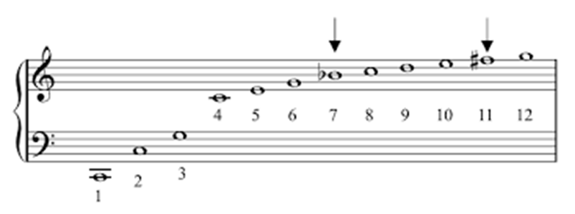
Vowels (overtones)
Uniform vowels reinforce overtones! And…
…stronger overtones = larger, fuller sound
Overtone series: 8-5-4-3-m3-2-m2 etc.
Overtone sympathetic vibrations via keyboard
Strength of partials vary by vowel
Two different vowels on same pitch = out of tune
Example…common variants of [ɑ]: ʌ ə ʊ
Exercise:
Unison sequence for uniformity: ɑ-ɛ-i-ɔ-u
Notes:
Keyboard demo overtone sympathetic vibrations
30-voice ensemble in tune stronger than 100-voice ensemble out of tune

Slide 21
Building choral sound: dynamics

Slide 22
Building choral sound: color
Examples:
Average-to-bright-to-warm: Lux Aurumque
Dark, warm: Deep river

Slide 23
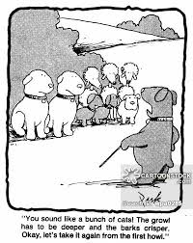
Chord balance in tonal music
Are all pitches equal???
Order of strength (strong to weak)
Chord root (lower stronger than higher)
Fifths
Thirds
Sevenths
Other dissonant color pitches

Slide 24
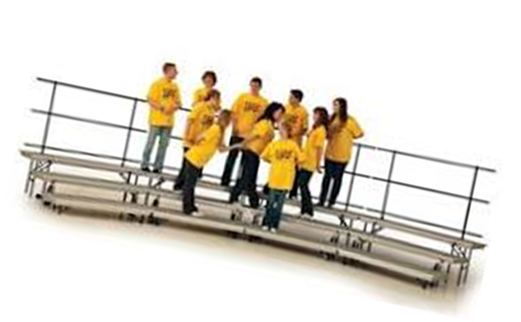
Singer placement within sections
Criteria: height, weight, best friend, largest donation to the choir fund?
Placement based on…
Tone color
Voice strength
(plus reading ability?)
Procedure:
Choose common song
Mix/match for optimum blend

Slide 25
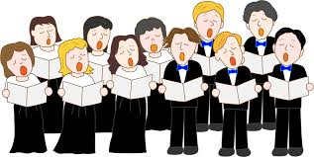
Closing…
The ingredients of good choral sound…
…many and varied aspects
…doesn’t happen automatically
…strong singers $≠$ good choral sound
…requires intentional focus
…hard work
…patience
The journey is part of our calling…
…moving our singers towards excellence
…and a life-long love of choral beauty

Slide 26
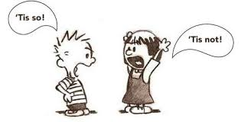
Questions…arguments…comments?

